Slide 1
Lower bound for sorting, radix sort
COMP171

Slide 2
Lower Bound for Sorting
Mergesort and heapsort
  worst-case running time is O(N log N)
Are there better algorithms?
Goal: Prove that any sorting algorithm based on only comparisons takes Ω(N log N) comparisons in the worst case (worse-case input) to sort N elements.

Slide 3
Lower Bound for Sorting
Suppose we want to sort N distinct elements
How many possible orderings do we have for N elements?
We can have N! possible orderings (e.g., the sorted output for a,b,c can be a b c, b a c, a c b, c a b, c b a, b c a.)

Slide 4
Lower Bound for Sorting
Any comparison-based sorting process can be represented as a binary decision tree.
  Each node represents a set of possible orderings, consistent with all the comparisons that have been made
  The tree edges are results of the comparisons

Slide 5
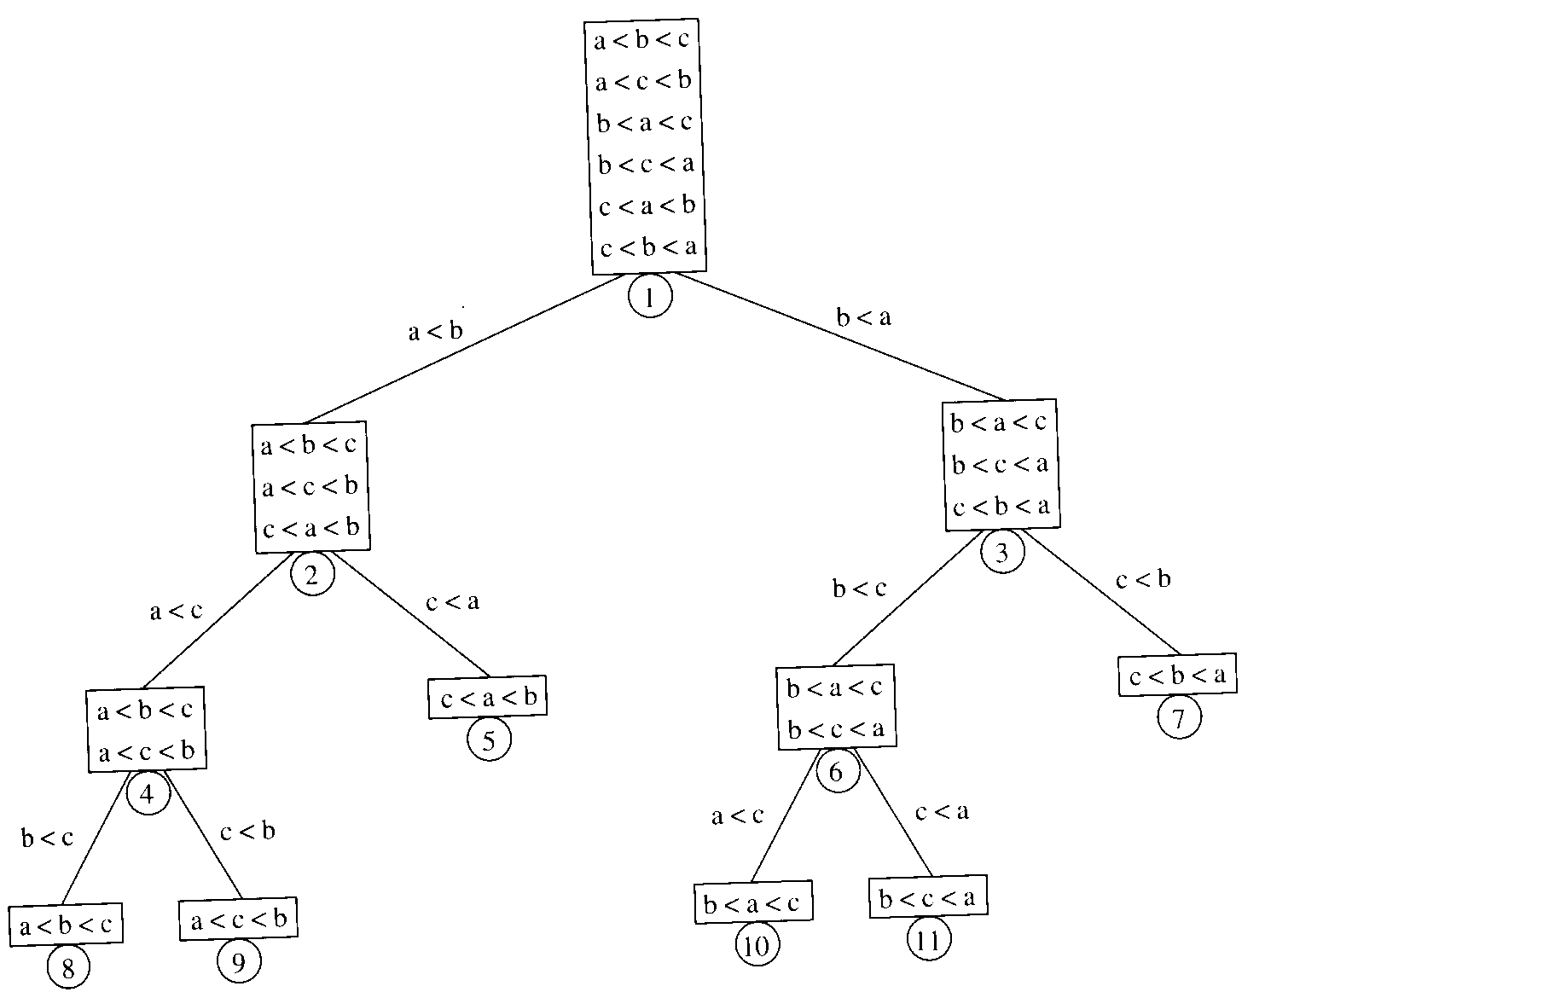
Decision tree for
Algorithm X for sorting
three elements a, b, c

Slide 6
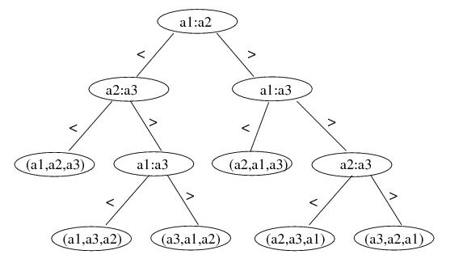
Lower Bound for Sorting
A different algorithm would have a different decision tree
Decision tree for Insertion Sort on 3 elements:
There exists an input ordering that corresponds to each root-to-leaf path to arrive at a sorted order. For decision tree of insertion sort, the longest path is O(N²).

Slide 7
Lower Bound for Sorting
The worst-case number of comparisons used by the sorting algorithm is equal to the depth of the deepest leaf
  The average number of comparisons used is equal to the average depth of the leaves
A decision tree to sort N elements must have N! leaves
  a binary tree of depth d has at most 2^{d} leaves
  ⇒ a binary tree with 2^{d} leaves must have depth at least d
  ⇒ the decision tree with N! leaves must have depth at least ⎡log₂ (N!)⎤
Therefore, any sorting algorithm based on only comparisons between elements requires at least
⎡ log₂(N!) ⎤ comparisons in the worst case.

Slide 8
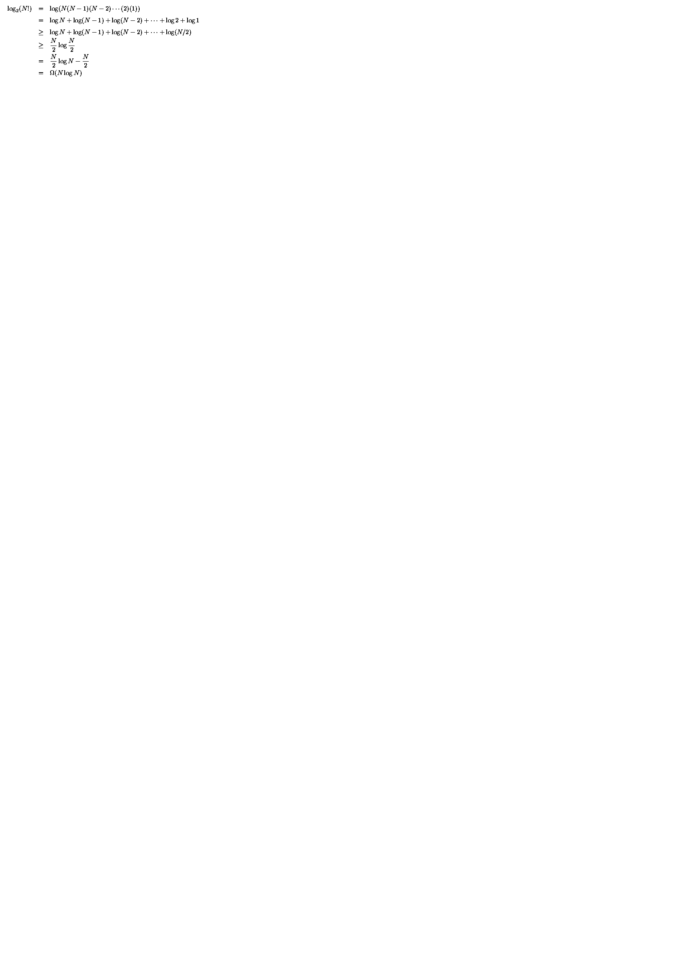
Lower Bound for Sorting
Any sorting algorithm based on comparisons between elements requires Ω(N log N) comparisons.

Slide 9
Linear time sorting
Can we do better (linear time algorithm) if the input has special structure (e.g., uniformly distributed, every number can be represented by d digits)? Yes.
Counting sort, radix sort

Slide 10
Counting Sort
Assume N integers are to be sorted, each is in the range 1 to M.
Define an array B[1..M], initialize all to 0 ⇒ O(M)
Scan through the input list A[i], insert A[i] into B[A[i]] ⇒ O(N)
Scan B once, read out the nonzero integers ⇒ O(M)
Total time: O(M + N)
  if M is O(N), then total time is O(N)
  Can be bad if range is very big, e.g. M=O(N²)
N=7, M = 9,
Want to sort 8 1 9 5 2 6 3
1
2
3
5
6
8
9
Output: 1 2 3 5 6 8 9

Slide 11
Counting sort
What if we have duplicates?
B is an array of pointers.
Each position in the array has 2 pointers: head and tail. Tail points to the end of a linked list, and head points to the beginning.
A[j] is inserted at the end of the list B[A[j]]
Again, Array B is sequentially traversed and each nonempty list is printed out.
Time: O(M + N)

Slide 12
Counting sort
M = 9,
Wish to sort 8 5 1 5 9 5 6 2 7
1
2
5
6
7
8
9
5
5
Output: 1 2 5 5 5 6 7 8 9

Slide 13
Radix Sort
Extra information: every integer can be represented by at most k digits
  d₁d₂…d_{k} where d_{i} are digits in base r
  d₁: most significant digit
  d_{k}: least significant digit

Slide 14
Radix Sort
Algorithm
  sort by the least significant digit first (counting sort)
  => Numbers with the same digit go to same bin
  reorder all the numbers: the numbers in bin 0 precede the numbers in bin 1, which precede the numbers in bin 2, and so on
  sort by the next least significant digit
  continue this process until the numbers have been sorted on all k digits

Slide 15
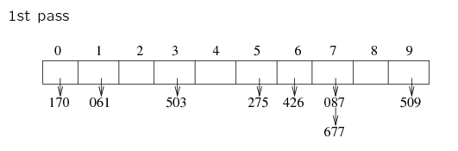
Radix Sort
Least-significant-digit-first
Example: 275, 087, 426, 061, 509, 170, 677, 503
170 061 503 275 426 087 677 509

Slide 16
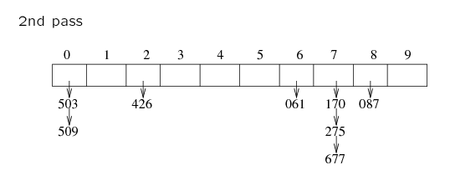
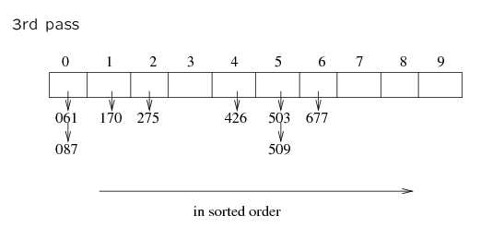
170 061 503 275 426 087 677 509
503 509 426 061 170 275 677 087
061 087 170 275 426 503 509 677

Slide 17
Radix Sort
Does it work?
Clearly, if the most significant digit of a and b are different and a < b, then finally a comes before b
If the most significant digit of a and b are the same, and the second most significant digit of b is less than that of a, then b comes before a.

Slide 18
Radix Sort
Example 2: sorting cards
  2 digits for each card: d₁d₂
  d₁ = ♠♥♣♦: base 4
    ♦ ≤ ♣ ≤ ♥ ≤ ♠
  d₂ = A, 2, 3, ...J, Q, K: base 13
    A ≤ 2 ≤ 3 ≤ ... ≤ J ≤ Q ≤ K
  ♦2 ≤ ♣2 ≤ ♥5 ≤ ♠K

Slide 19
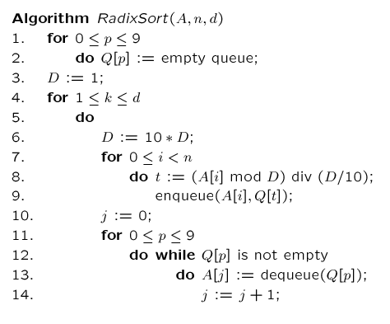
A=input array, n=|numbers to be sorted|,
d=# of digits, k=the digit being sorted, j=array index
// base 10
// FIFO
// d times of counting sort
// scan A[i], put into correct slot
// re-order back to original array

Slide 20
Radix Sort
Increasing the base r decreases the number of passes
Running time
  k passes over the numbers (i.e. k counting sorts, with range being 0..r)
  each pass takes 2N
  total: O(2Nk)=O(Nk)
  r and k are constants: O(N)
Note:
  radix sort is not based on comparisons; the values are used as array indices
  If all N input values are distinct, then k = Ω(log N) (e.g., in binary digits, to represent 8 different numbers, we need at least 3 digits). Thus the running time of Radix Sort also become Ω(N log N).

